Slide 1
Easy Assessments for K-5 Music Classes
Shared by Denise Gagné
Oct 6, 2021

Slide 2
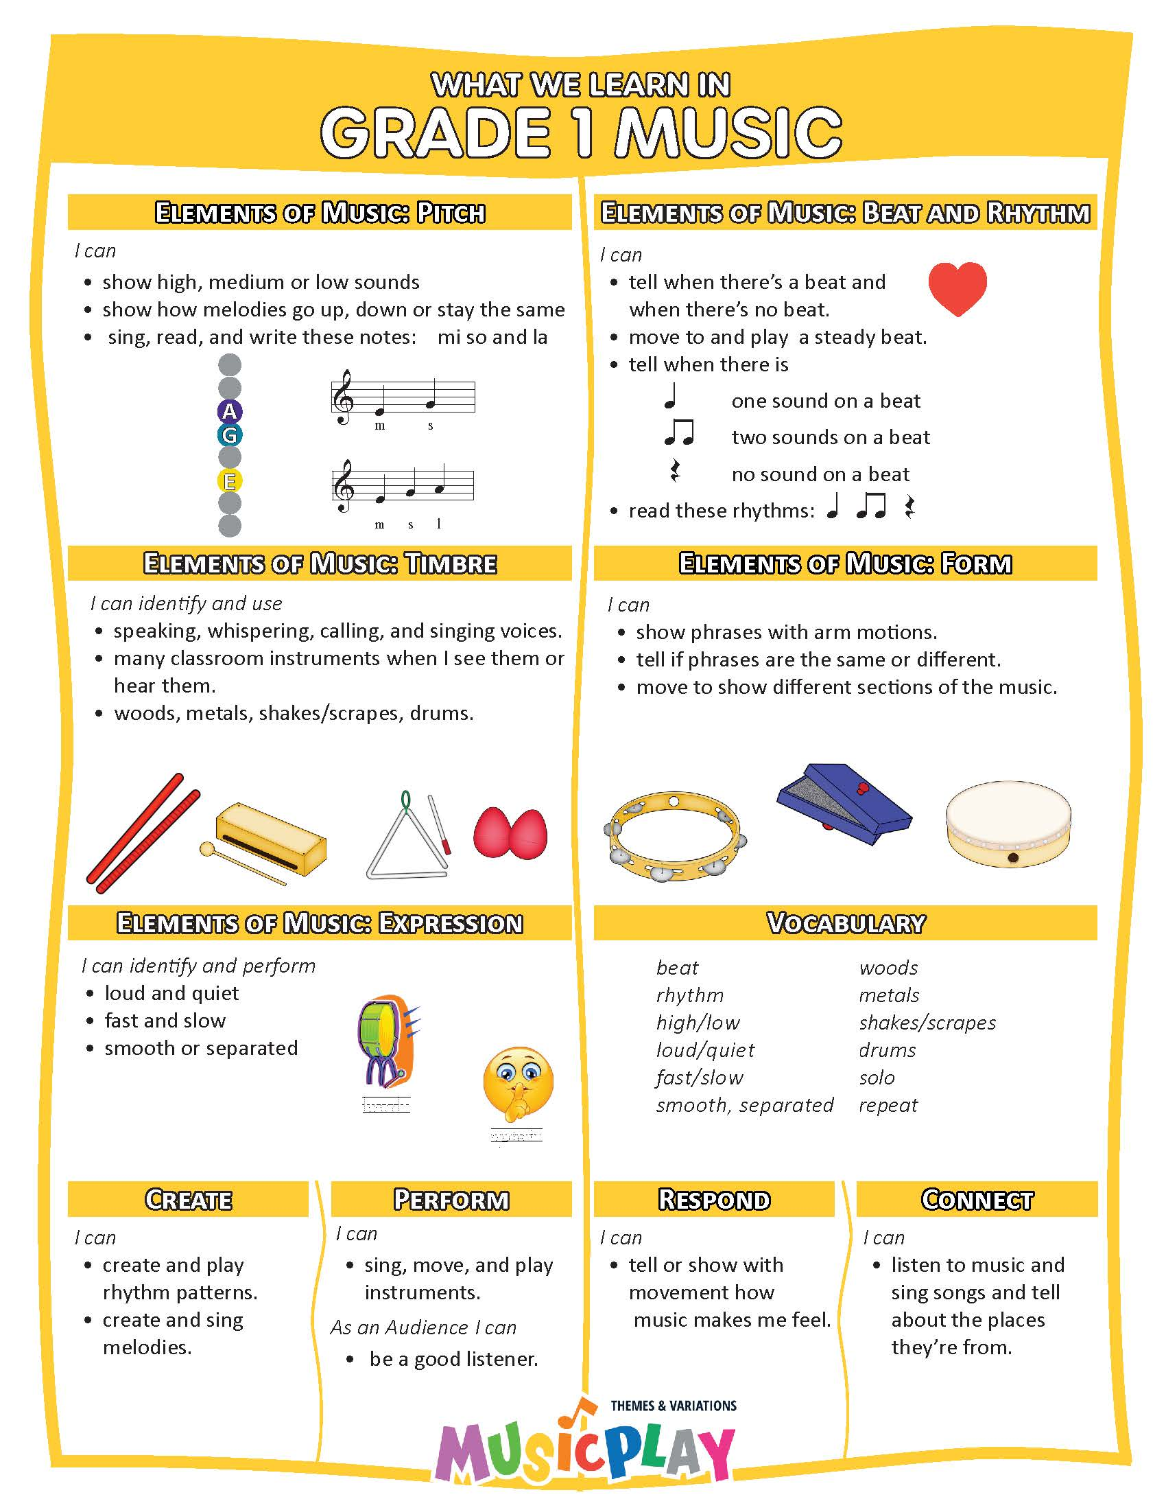
What to Assess?
1. Sing - match pitch
2. Steady beat – non-locomotor
3. Steady beat - tap, move
4. Play steady beat
5. Reads Rhythm
6. Plays Instrument correctly
7. Timbre – voices, rhythm instruments
And More!

Slide 3
Assess – Pitch Matching (in-tune singing)
Hello Attendance – Hello Sara. Hello Mrs. Gagne
Improvise Question/Answer – What kind of costume do you like?
Sing to Melody the Elephant
Echo Bobo
Name Games – Concentration, Number Concentration
Guessing Games – Doggie Doggie, Mr. Potato Head,
Call and Response songs – sing response alone – Fastest Turkey
Sing a phrase of a song alone – solo/class/solo/class – Counting Song

Slide 4
Rubrics

Slide 5
Assess – Steady Beat with non-locomotor
Action or movement song – observe movement
Time for Music! Elephants Have Wrinkles Shake it!
2. Copycat with a short classical example
Listening Kit 1, #36
3. Rhythm Practice – Prepare Rhythm – Move to the Beat (more will be created!)

Slide 6
Assess – Steady Beat with locomotor movement
Observe students as they sing and move to a movement song:
Hey Betty Martin, Hop Old Squirrel, Choo Choo Train, Engine #9
Snail Snail, - any song where they travel 2. Play follow the leader with a piece of classical music. Find one with a strong, steady beat, about 120 BPM

Slide 7
Assess – Rhythm Reading
Read Rhythm Patterns in Rhythm Practice Section
Flashcards are in Levels 4-12a and will be in more sections soon!
Rhythm Practice – Rhythm Reading Assessment – great to assess a whole class in just 3-4 minutes.
Read the rhythm of a song!
Do Rhythm Play Along with instruments - Instrument section-Unpitched
Looking for Dracula
Assessment rubrics/cheklists are in Lesson Planning-Planning Resources for each grade.

Slide 8
Assess – Instrument Playing Ability
Observe as students play unpitched
Instruments-Unpitched-Play, Play, Play Along; Piano Roll
Observe as students play on barred instruments
PK-K-1 play a solid bordun with a simple reading song – Counting Song.
2-3-4-5 play a part of an Orff arrangement – Gr 2 Time to Play
- Gr 3: Rocky Mountain

Slide 10
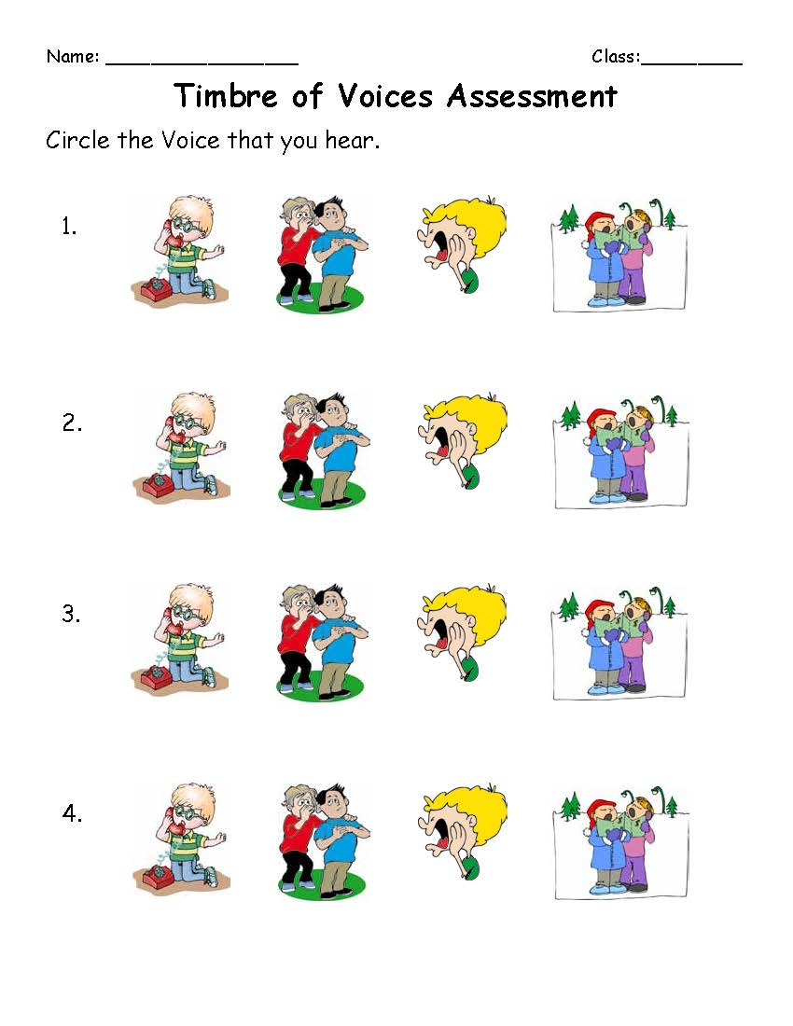
Assess – Timbre
4 Voices Activity
K - #7 This is my Speaking Voice
– use 4 Voice Interactive/printable

Slide 11
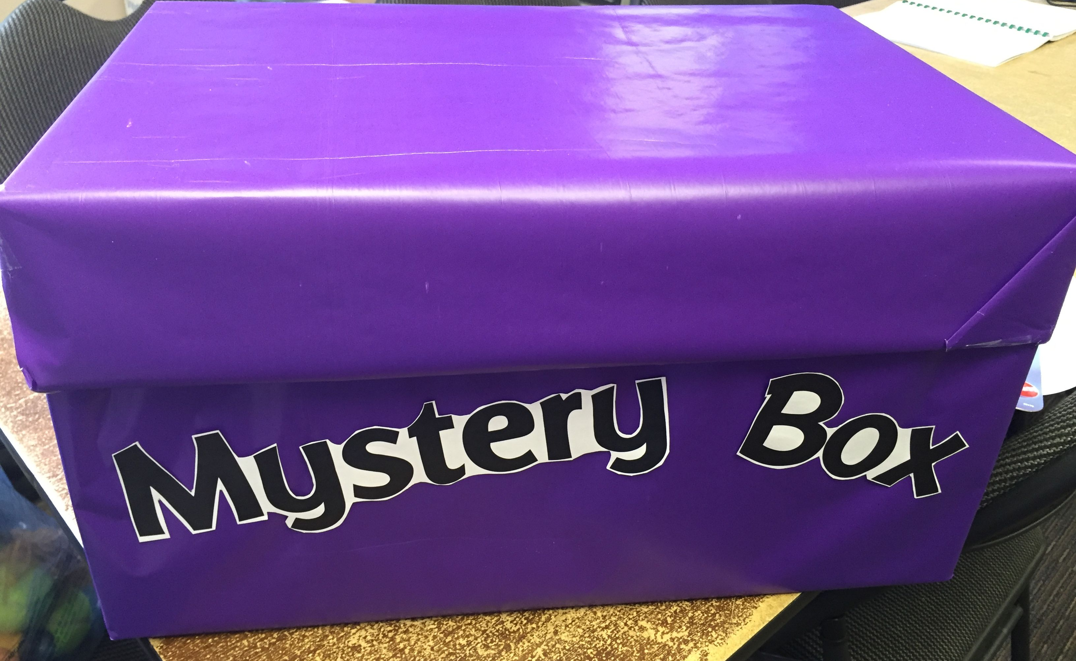
Assess – Timbre
Mystery Box – do aurally with littles, do a written assessment with older students

Slide 12
Assess – Timbre
3. What Instrument Did You Hear? Game – use to Assess

Slide 13
Assess – Timbre
Assessments in Units - Orchestra Unit

